Slide 1
Towards a machine learning framework for metabolic pathway classification based on metabolic correlation networks.
Kostya Kilimnik
Supervisor: Dr. Rami Puzis
Advisor: Dr. David Toubiana
December 2016

Slide 2
Overview
Problem Domain : Study of complex discrete structures within the context of a large network and its application on biological data
Goal : Modular framework for metabolic pathway inference from high throughput metabolite profile data without the need for a priori knowledge
Data : Metabolite profile datasets from number of different species
Desired Output : Given an arbitrary pathway, model will determine whether or not this pathway exists in an explored species tissue
Metabolomics
Network
Science
Machine
Learning
Notes:
Goal: Instead of manual choice of good candidates for active not yet identified pathway in specie ( based on theoretical knowledge and expertise) , framework automatically poses best candidates for wet experiment or analytical exercise. Motivation : only small part of metabolic pathways is known

Slide 3

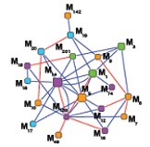

Glossary
Metabolism
Term that is used to describe all chemical transformations involved in maintaining the living state of the cells and the organism.
Metabolic pathway
Genetically driven series of chemical transformations that produce or degrade substrates (other metabolites).
Graph embedding
Representation of graph in vector space
Correlation network
Node = feature/entity
Link = correlation
Weight = correlation coefficient
Metabolic profiling
Identification and (relative) quantification of as many compounds as possible via high throughput techniques (GC-TOF-MS, GC/LC-MS,NMR …)
Metabolite
Intermediate and end products of metabolic transformations catalyzed by various enzymes that occur within cells
Vector
[ f1 f2 f3 f4 ]
Notes:
מטבוליטים ראשוניים ומשניים. מטבוליזם הוא תהליך קליטת חומרים מהסביבה, עיבודם, הפקת אנרגיה מהם ופליטת הפסולת בייצורים חיים

Slide 4




Research Objectives and significance
Develop generic and modular data analysis framework for subgraph classification which can be used in multiple domains and various collected datasets that fit our analytical model.
Apply the framework on tomato pericarp three season data. Prove its effectiveness on other species metabolic profiles data. Predict unmapped pathways and analyze top rank predictions with domain experts.
Different annotations for same metabolite in profile data and metabolic pathway repository
Without wet experiment we can not fully verify result of prediction on unmapped pathway
Classification of partial metabolic pathways based on the weak ties from CNs
Proposed framework can serve as decision supporting tool for the researchers of application domain (systems biology, security etc.) if proved efficient
Platform for further research on subgraph classification and search methods

Slide 5
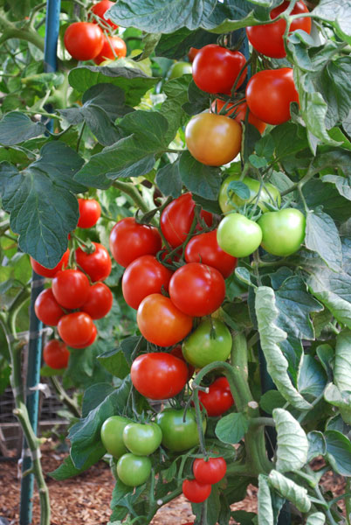

Dataset
76 introgression lines (ILs) in tomato developed by crossing domesticated Solanum Lycopersicum (M82) and distant wild relative S. pennellii
3 seasons (2001,2003,2004)
Metabolic profiling by GS-MS analysis
64 quantified metabolites in all seasons
169 known tomato metabolic pathways with partial-to-full coverage in obtained profile data

Slide 6




Proposed solution - Learning
Metabolites
 | Glucose | Proline | Sucrose | …
IL1 | 2.039 | 0.56 | 0.31
IL2 | 0.43 | 0.62 | 0.76
IL3 |  | 1.65 | 0.43
IL4 | 1.29 |  | 0.45
…
Preprocessing
MCN generation
Samples
Sub-graph embedding
Sub-graph mapping
Statistical learning
Pathway repository
Train matrix
Model
Cross validation
Feature generation/selection

Slide 7


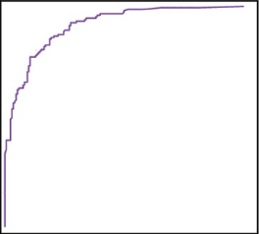
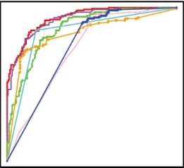
Proposed solution - Prediction
pathway
query
sub-graph
vector
hypothesis
Model
X
X
embedding
mapping
Main research focus: Sub-graph embedding module
Goal : Identify best working sub-graph interpretation and optimal set of features in iterative process
Secondary focus: Machine learning module
Goal: Identify best working method on chosen sub-graph definition and set of features.
Criteria: method accuracy and interpretation
Evaluation: Accuracy + AUC
Notes:
Sub-graph interpretation : standard definition of subgraph or extended weighted interpolation ( include neighbors or neighbors of neighbors, weight can be distance in context of whole graph or number of shortest paths or some measure (Catz) etc.

Slide 8
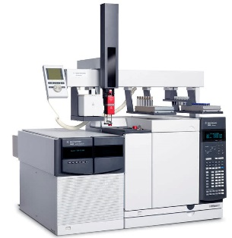
State of the art - Metabolomics
Steinfath, Matthias, et al. "Metabolite profile analysis: from raw data to regression and classification." Physiologia Plantarum 132.2 (2008): 150-161.
Data
ICA/PCA
Data preprocessing
(missing value estimation,
outlier detection)
GS-MS
Regression
Data transformation
(log10,log2,…)
Pairwise correlation
Data scaling
(unit vector form,z-score)
Discrimination
Normalization

Slide 9
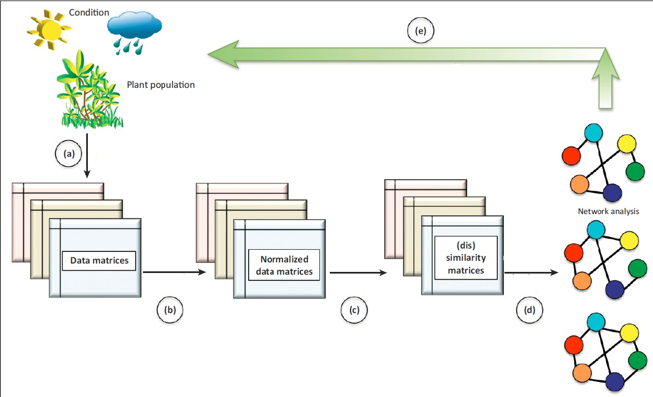
State of the art – Network Analysis
Toubiana, David, et al. "Network analysis: tackling complex data to study plant metabolism." Trends in biotechnology 31.1 (2013): 29-36.
Common network properties used for analysis
Node degree
Average path length
Diameter
Centrality (closeness, betweenness, eigenvector)
Clustering coefficient
Eccentricity
Repeat experiment with another season data
Metabolic screening
Tissue
specific
Similarity
measure
Network
generation
Network analysis
If similarity measure = correlation then generated weighted network is called metabolic correlation network (MCN)
Notes:
מה זה אומר אם יש קורלציה גבוהה בין המטבוליטים. התנהגות מתואמת.

Slide 10

State of the art – Graph/Sub-graph embedding
D. Toubiana
Subgraph embedding by brute force global/local feature calculation in MCN successfully revealed the melibiose degradation pathway in the tomato pericarp. Wet lab is in final stages.
+ network analysis facilitates understanding of hidden processes and predicts system behavior in some scenarios
- absence of robust generic models and immaturity of the network mining techniques compared to standard relational data space
Graph embedding
Riesen, K., & Bunke, H. (2010). Graph classification and clustering based on vector space embedding.
Global features | Vertex/link features | Local structures
Clustering coefficient | Centrality measures | Motifs
Diameter, average path length, density, modularity | Common neighbors, Jaccard, Kats, Adamic, Friends measure | Graphlets
 | Preferential attachment
Notes:
Embedding by global features is straight forward, but they don’t cover most of network structure aspects, have different numeric ranges, some don’t scale well
Local features can be aggregated for sub-graphs or entire network ( median + 4 moments). Graphlets and motifs catch local neighborhood structure but can not capture community or distant node relationships. There is a need in unsupervised feature generation. Recently, there is a big progress in complex networks modelling by neural networks. Due to time constraints there is no review of NN methods here, but DeepWalk, Deep Graph kernels, and CN for graphs are steps in right direction.
for the pathway analysis: David ran RT-PCR analysis and the results are very good, showing that specifically in the M82 the expression of alpha-galactosidase (the enzyme catalyzing the degradation of melibiose to glucose and galactose) is quite high

Slide 11
Knowledge gaps
There are no methods for subgraph embedding that can take into account the context of its enclosing network.
There are no methods to generate global network features that are not based on expert knowledge.
No covering set of global features, no consensus on best set. There is a need in unsupervised methods of feature generation without human expertise.
Relationships between biochemically distant pathways are difficult to extrapolate from metabolite networks.

Slide 12
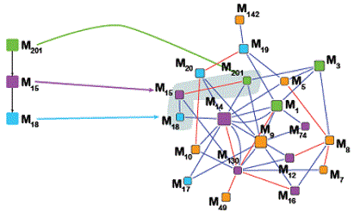
Preliminary Results
Sukrit, Gupta, Puzis Rami, and Kilimnik Konstantin. "Comparative Network Analysis Using KronFit." Complex Networks VII. Springer International Publishing, 2016. 363-375.
New network similarity measure was introduced called FittingDistance(FD) based on KronFit algorithm. Evaluation on five classes of real networks showed that this class of distances performs surprisingly well
Metabolite direct classification attempts on Italian sparkling wine profile data failed, supporting our hypothesis that only topology of underlying correlation network encompasses important knowledge on function and dynamics of the system
Framework implementation: first modules for raw data preparation and MCN generation are completed. Module for pathway mapping in MCN is under work.
Notes:
for the classification of the wine classes David achieved very good results using a combined network analysis machine learning based approach. Creating binary classes for the 6 classes he obtained models for each at around 85% accuracy and ~.9 ROC. Now he wants to check if this can be improved using co-training

Slide 13


Next Steps
Basic implementation of graph embedding and ML modules in framework
Experiment design
Iterative process of running framework with different approaches to sub-graph embedding and feature selection
Analytical research on best/worst iterations
Experiments with negative instances population design. Random subsets of metabolites vs real not yet identified pathways
Completion of framework implementation
Experiments with different datasets and robustness analysis
Open source distribution of framework
Thesis

Slide 14


